Slide 1
Transfer learning
Инна Тужикова, 17.04.2019

Slide 2
Transfer learning: idea
Transfer learning is a machine learning method where a model developed for a task A is reused as the starting point for a model on a task B.

Slide 3

ImageNet Large Scale Visual Recognition Competition (ILSVRC)
Object classes: 1000. Images: 1.2 M train, 100k test

Slide 4
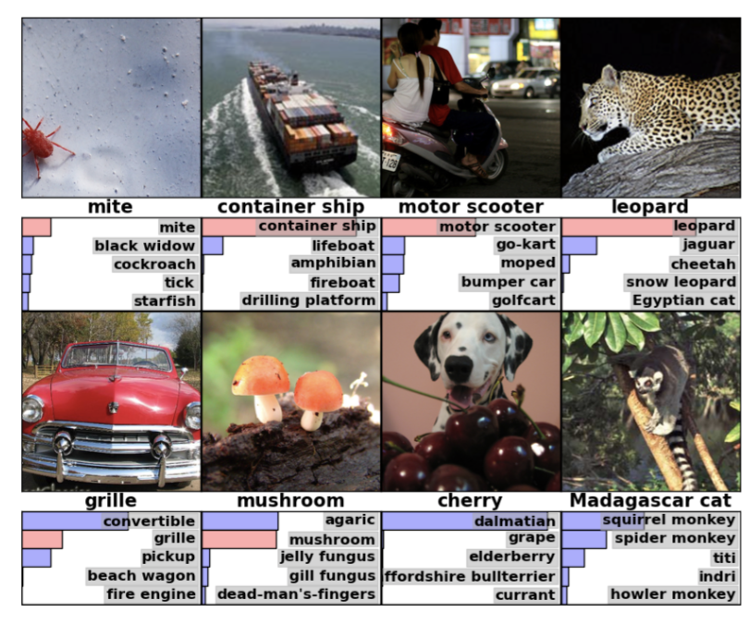

Slide 5
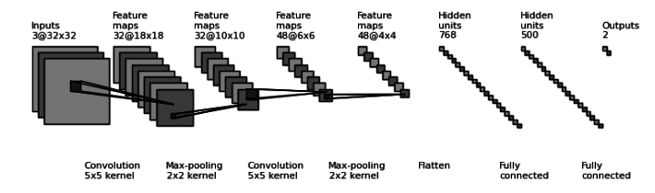
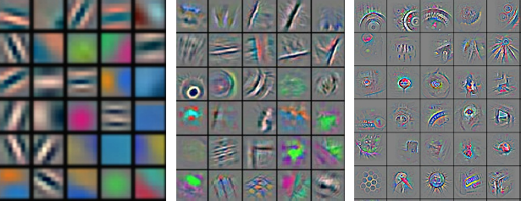
General vs specific

Slide 6
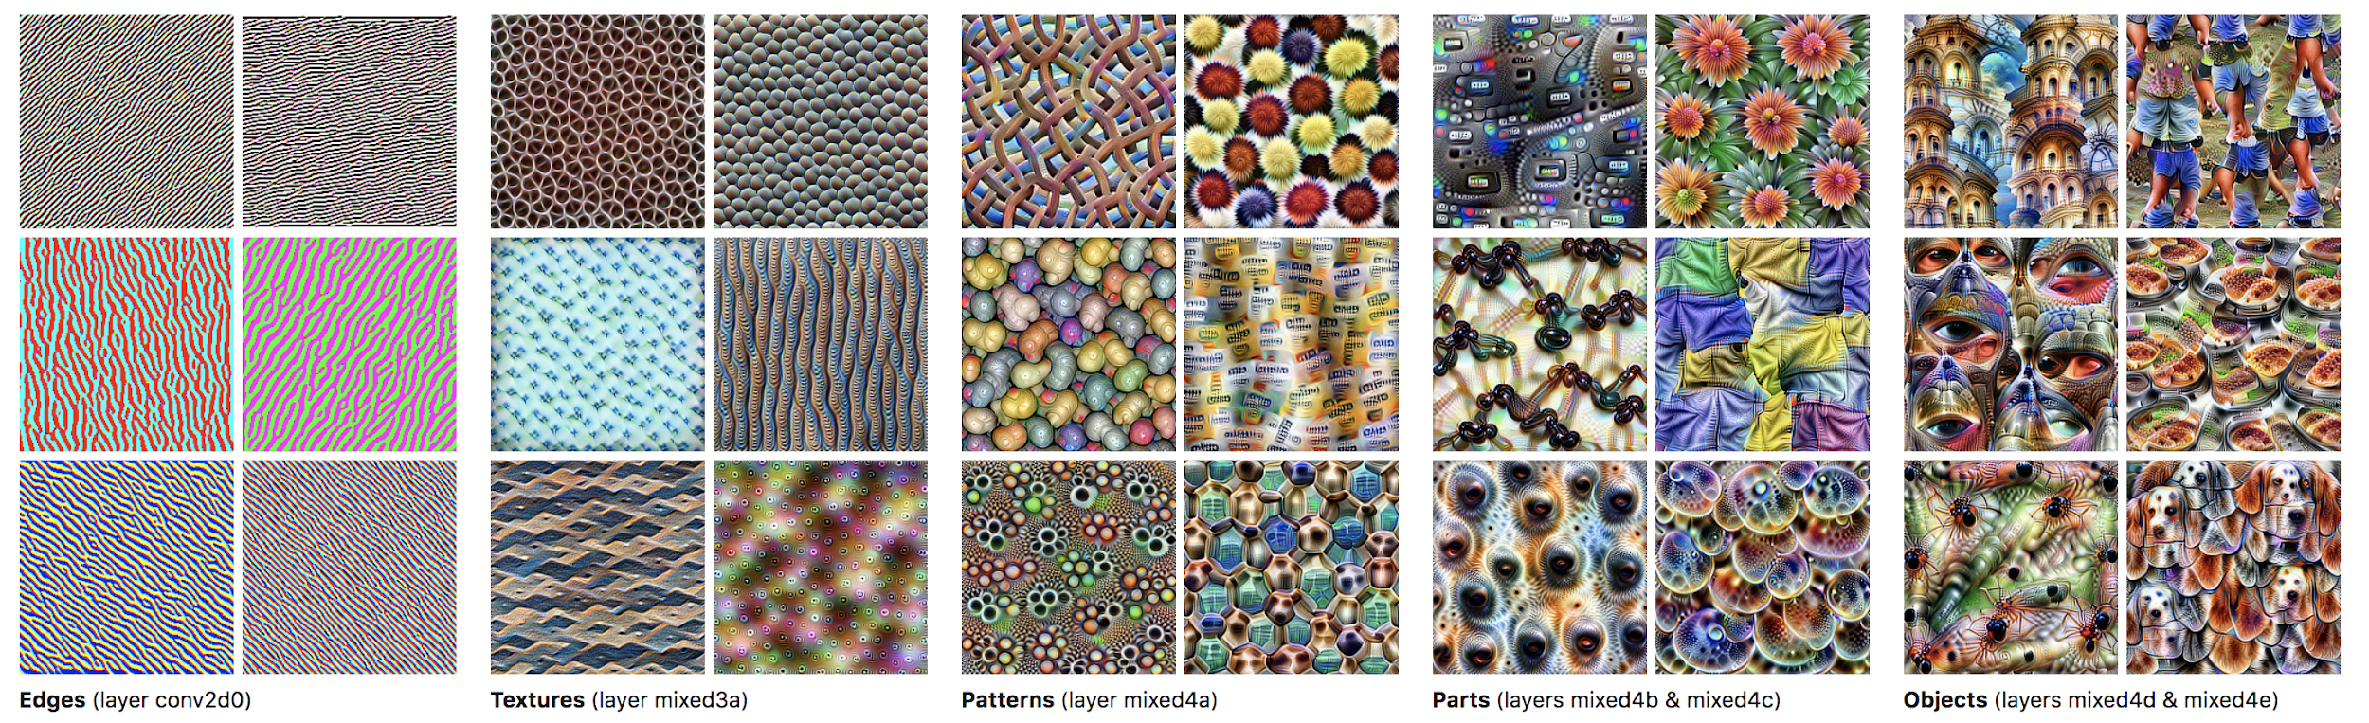
General vs specific

Slide 7
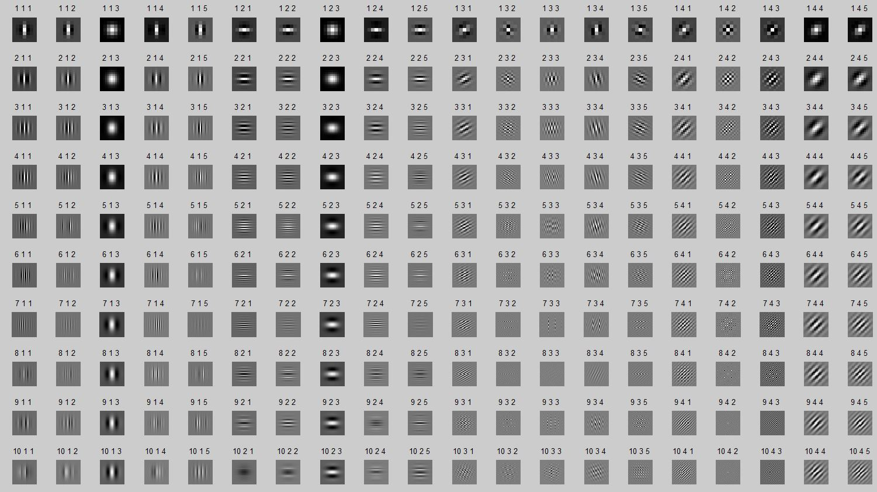
Gabor filters

Slide 8
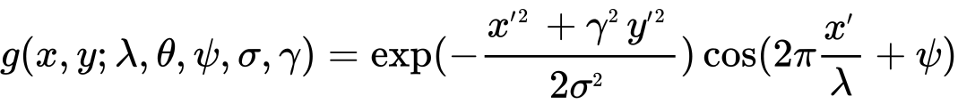
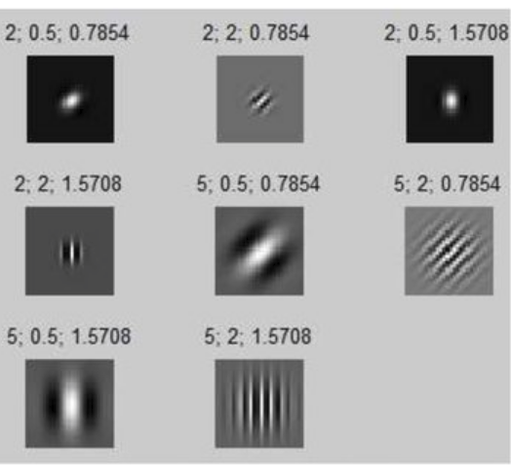
Gabor filters

Slide 9
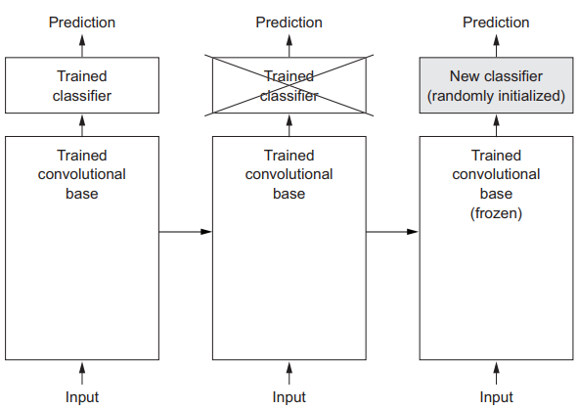
Feature extraction
Feature extraction consists of using the representations learned by a previous network to extract interesting features from new samples. These features are then run through a new classifier, which is trained from scratch.

Slide 10
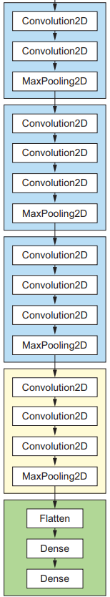
Fine-tuning
UNFREEZED BACKBONE + CUSTOM HEAD + BACKPROPAGATION
Replace and retrain the classifier on top of the pretrained neural network on the new dataset, but to also fine-tune the weights of the backbone by continuing the backpropagation.
FINE-TUNE:
ALL LAYERS
FIX LOW-LEVEL
ONLY HIGH-LEVEL

Slide 11
Fine-tuning
1. Add your custom HEAD on a top of pretrained BACKBONE.
2. Freeze the BACKBONE.
3. Train the HEAD.
4. Unfreeze some layers in the BACKBONE.
5. Jointly train (low lr) unfreezed layers + HEAD.

